Slide 1
Multivariate Regression with Categorical Responses
Robert Nakano robertnakano@gmail.com
Sunny Jelokhani afsanehkhani35@gmail.com
Ziyi Wang joannewangziyi@gmail.com
Link to slides: https://docs.google.com/presentation/d/1HYRW68cL9_nJitRq7p0i-zVp6liPaq6W4dw9IZJu1HQ/edit?usp=sharing

Slide 2
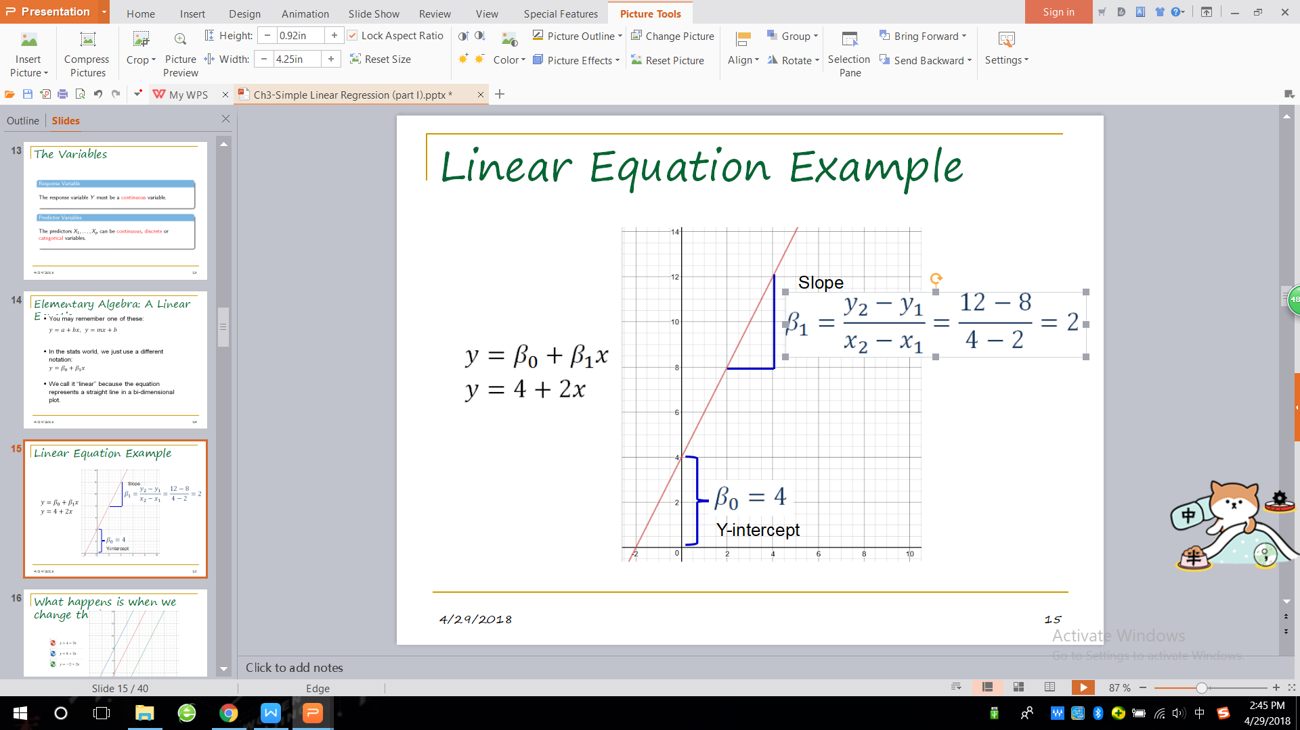
Question?
We’ve learned how to model with a numeric response variable
But, What if the response
variable (Y) iS NOT NUmeriC?

Slide 3
Outline:
Overview of Categorical Responses
Case Study : Predicting personalities (binary)
Case Study: Epidemic outbreak of a disease (ordinal)

Slide 4
Categorical Data & Reponses
What is a categorical response?
Response data that is measured by categories instead of continuously.
Also called: Qualitative (vs. Quantitative),
Qualitative:
Color of a sample
Texture of a surface
Aroma of a reaction
Quantitative:
Mass of a sample
Length of a piece of wire
Molecules in a mole

Slide 5
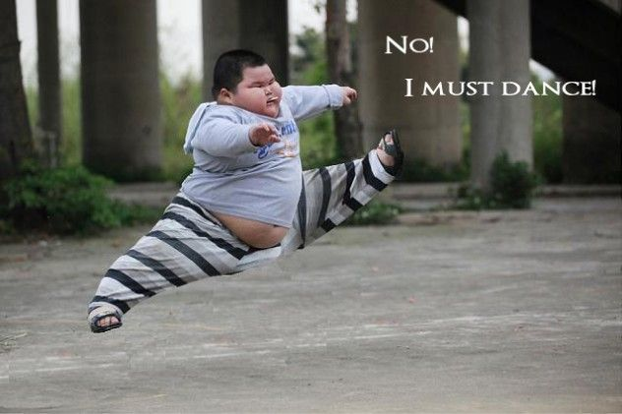
Binary: 1 or 0
The response variable is one of two things.
Smoker or Non-smoker
Netflix Thumbs up or Thumbs down
People who dance in front of the mirror or people who don’t dance in front of the mirror
Types of Categorical Responses

Slide 6

BIG CONCEPT
If a variable is not binary, it is Polytomous
Polytomous (more than 1 outcome)
Type of Polytomous: Categorical Responses
Ordinal: On an ordered spectrum
Multiple Categories that can be ordered.
EXAMPLES:
E.g. How much do you like Dr. Ath’s class?
(1 - 4)
It’s pretty good
I love it!
Would leave my spouse to take it
Even better than Game of Thrones
Interval: numerical distance between data points

Slide 7

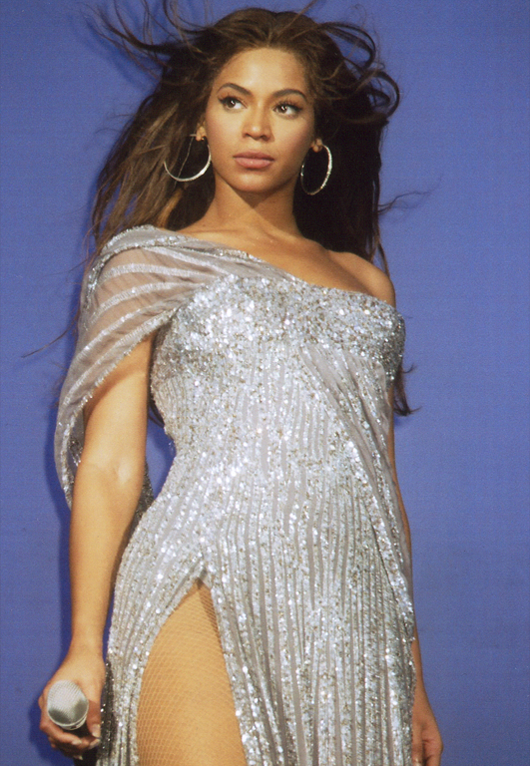
Types of Categorical Responses: Nominal
Nominal categorical responses have no order (unlike ordinal)
Worst Television Show?
iZombie, Santa Clarita Diet, Ironfist
Who is your favorite singer?
Taylor Swift, The Biebs, Beyonce, Shakira, Robert Nakano
Favorite Dessert? Tiramisu, Chocolate Souffle, Beef jerky, Froyo!

Slide 8

HOW DO YOU predict A Categorical Response?
It depends on what kind.

Slide 9

How Do You Predict a Categorical Response?
It depends on what kind: PERHAPS :
Binary-> Logistic Regression
Ordinal with irregular intervals -> Logistic Regression
Ordinal with even intervals -> Logistic Regression OR (decision tree) OR Linear Regression (like Ryan’s presentation on Predicting Map Difficulty with Dancing)
Nominal-> multinomial logit model

Slide 10
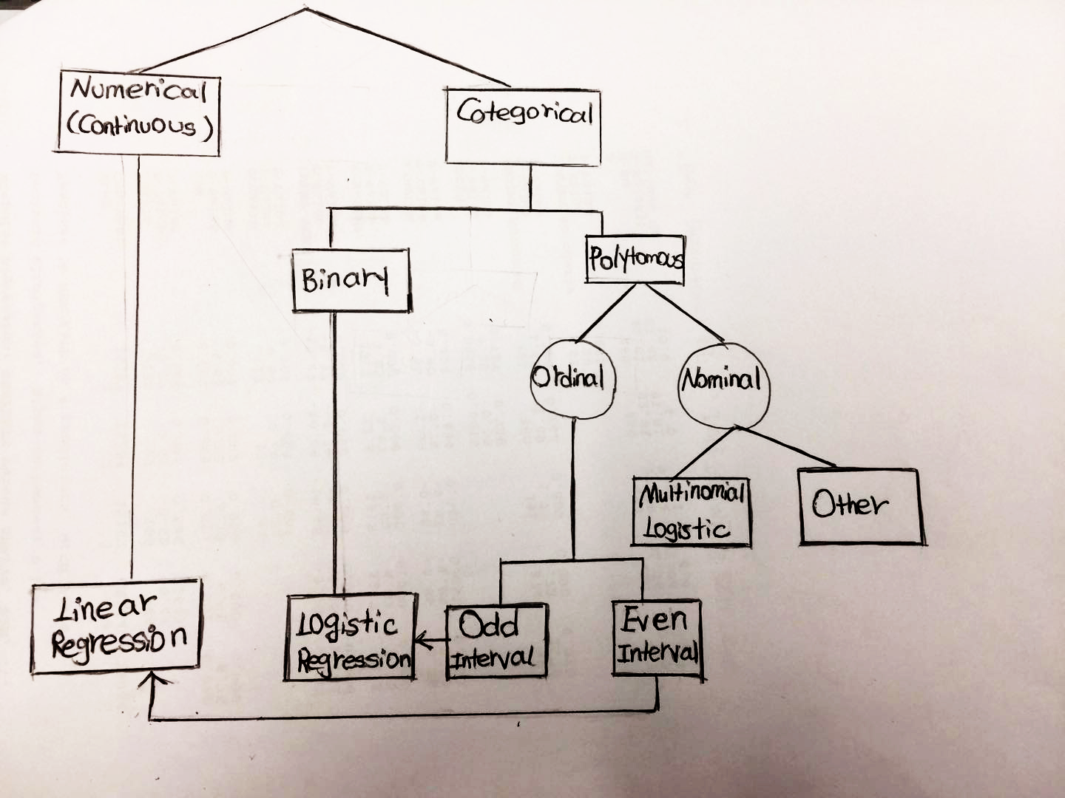
Linear or Logistic Regression Model?

Slide 11
WHY LOGISTIC REGRESSION IS NEEDED？
1. The residuals cannot be normally distributed (as the OLS model assumes), since they can only take on one of several values for each combination of level of the Independent Variables
2. The OLS model makes nonsensical predictions, since the DV is not continuous - e.g., it may predict that someone does something more than ‘all the time’. Something like 1.3 doesn’t make sense in a binary response.
3. For nominal DVs, the coding is completely arbitrary.
For Ordinal Data, a linear regression may make sense if they are evenly spaced.
E.g. 4.5 stars out of 5 (e.g. Ryan’s presentation)
How to predict a categorical response?
In statistics, logistic regression, or logit regression, or logit model[1] is a regression model where the dependent variable (DV) is categorical.

Slide 12


Assumptions for Logistic Regressions
Don’t Need
Doesn’t need to be linear
Distribution doesn’t need to be normal
Do Need:
Binary or ordinal data
Independent observations (no matched data)
Independent variables need to be linearly related to the log odds

Slide 13


Logistic Regression Formula:

Slide 14
Binary
A binary logistic model is used to estimate the probability of a binary response based on one or more predictor (or independent) variables (features).
Notes:
It allows one to say that the presence of a risk factor increases the odds of a given outcome by a specific factor. The model is a direct probability model and not a classifier.

Slide 15
https://www.analyticsvidhya.com/blog/2015/08/comprehensive-guide-regression/
R tutorial on running a logistic regression:
https://www.r-bloggers.com/how-to-perform-a-logistic-regression-in-r/
R tutorial on building a logistic regression from scratch:
https://www.analyticsvidhya.com/blog/2015/10/basics-logistic-regression/
Python walkthrough: https://towardsdatascience.com/logistic-regression-using-python-sklearn-numpy-mnist-handwriting-recognition-matplotlib-a6b31e2b166a
https://towardsdatascience.com/building-a-logistic-regression-in-python-step-by-step-becd4d56c9c8
SAS example:
http://support.sas.com/documentation/cdl/en/statug/63962/HTML/default/viewer.htm#statug_logistic_sect060.htm
References for R, SAS, & Python

Slide 16
Case Study: Using forum posts to predict a person’s personality

Slide 17
WHAT IS MBTI ?
The Myers Briggs Type Indicator (MBTI) is a personality type system that divides everyone into 16 distinct personality types across 4 axis:
· Introversion (I) – Extroversion (E)
· Intuition (N) – Sensing (S)
· Thinking (T) – Feeling (F)
· Judging (J) – Perceiving (P)

Slide 18
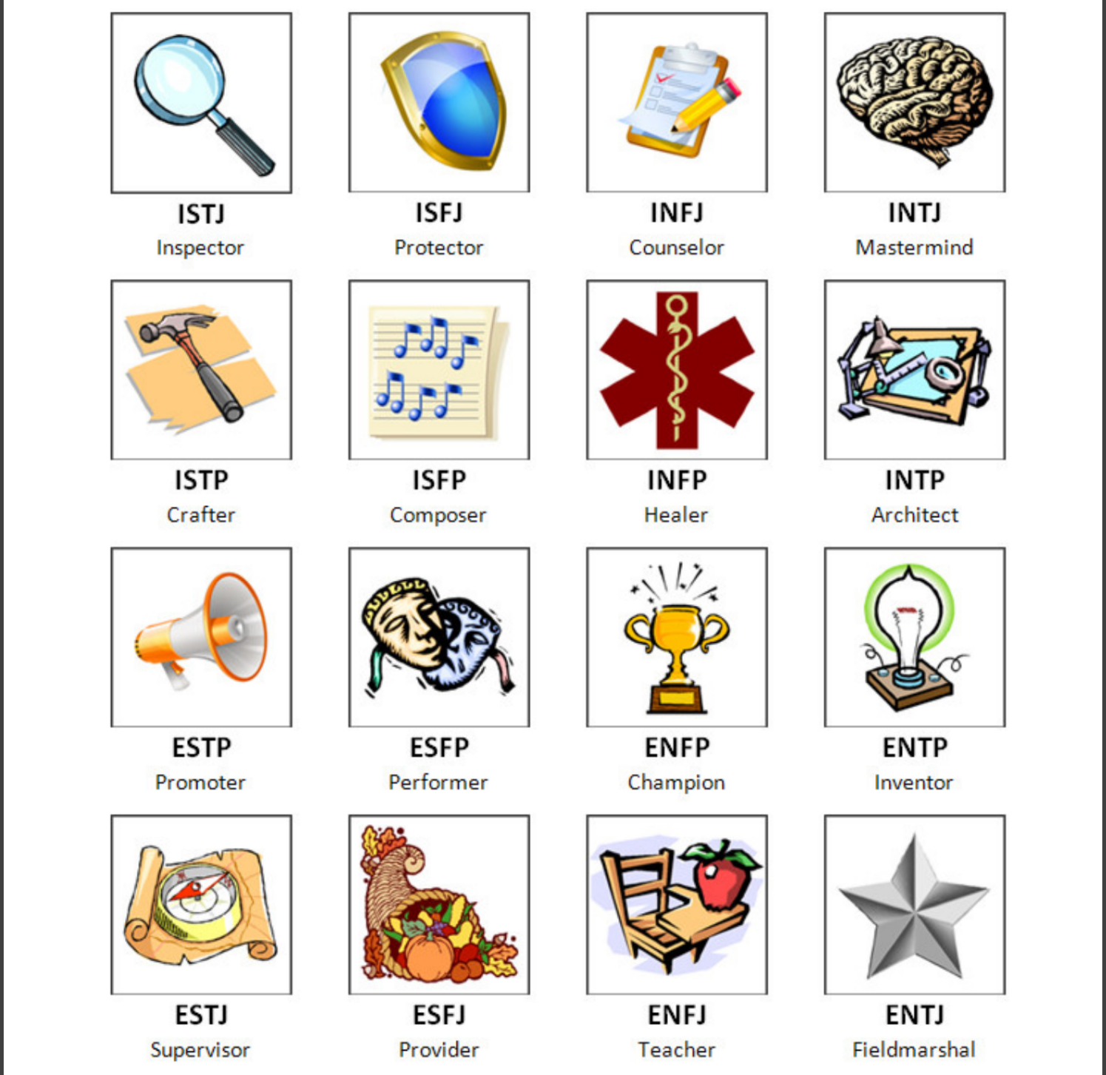
16
T
y
p
e
s

Slide 19

youtopiaproject.com
Notes:
https://youtopiaproject.com/youtopia-16-assessment/

Slide 20

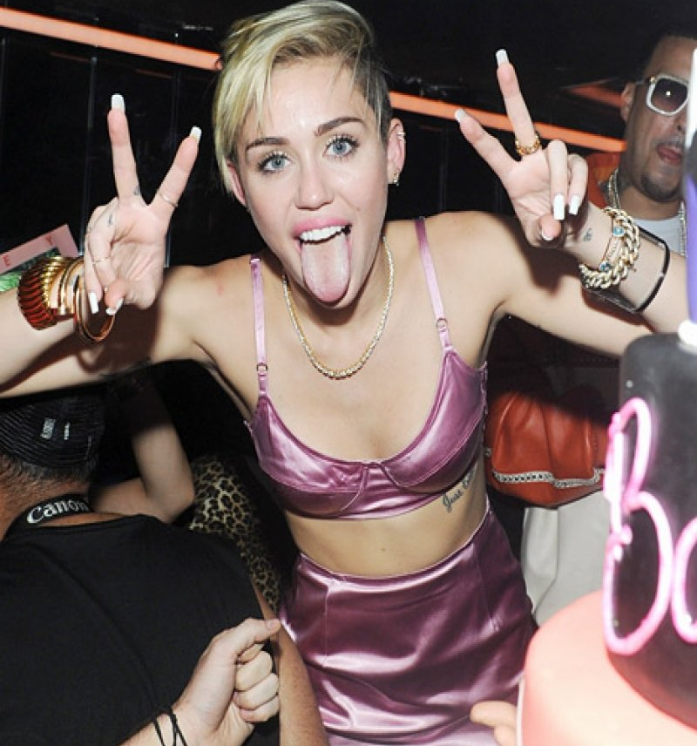
v.s
First axis I VS. E
Introverted
Extroverted
Notes:
https://www.twenty20.com/photos/1825e01e-3a43-43a8-929e-e0daa7d09cd1

Slide 21
First Indicator I VS. E
binary variable
I
N F P

Slide 22

Do using certain words indicate Introverted/Extrovertedness?
Do specific words indicate a certain temperament/personality???

Slide 23
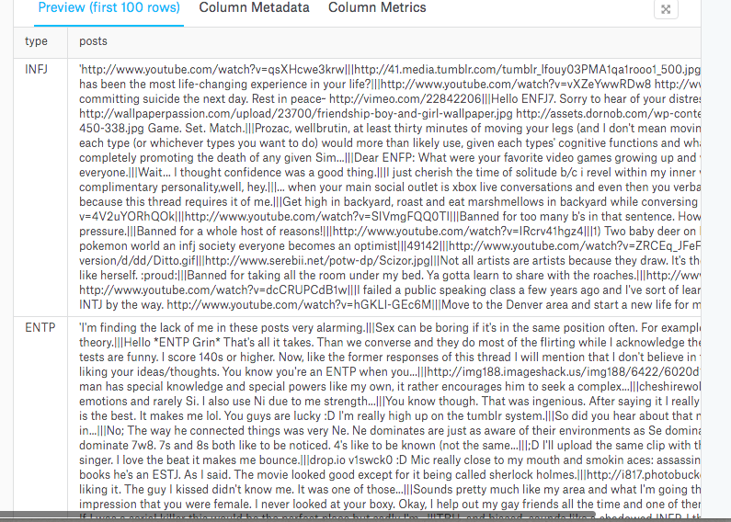
MBTI Dataset
https://www.kaggle.com/datasnaek/mbti-type/data

Slide 24
Do using certain words indicate a certain temperament?
Procedure
Clean data
Create a column for I vs. E (binary)
Tokenize/Vectorize dataset (bag of words)
Count words & create giant matrix
Run a logistic regression
Summarize data

Slide 25
Case Study: MBTI
Python code

Slide 26
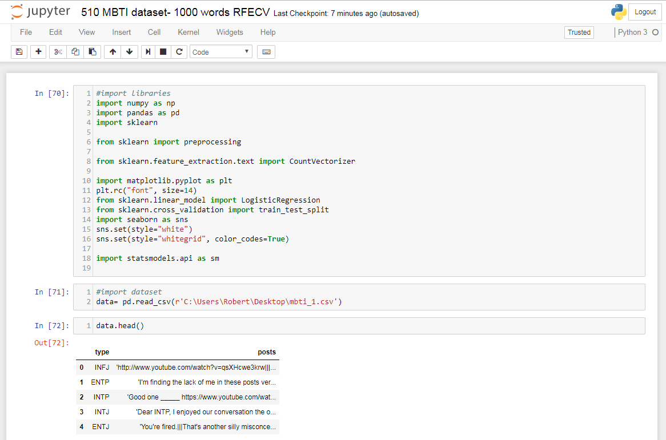

Slide 27
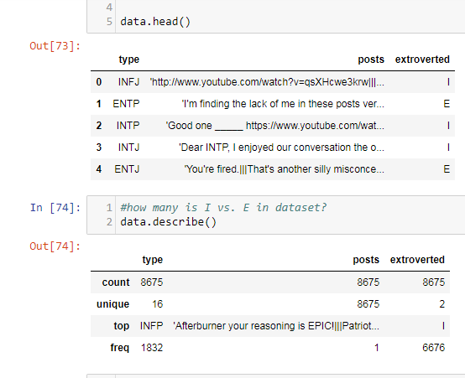
Our Data

Slide 28
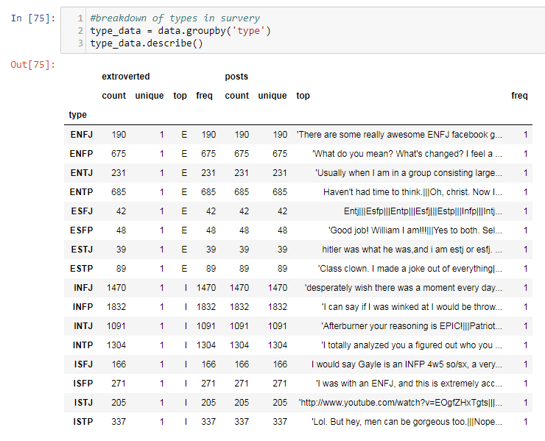

Slide 29
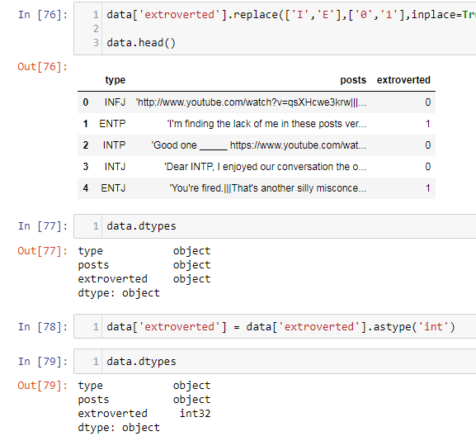
Make Binary Column

Slide 30
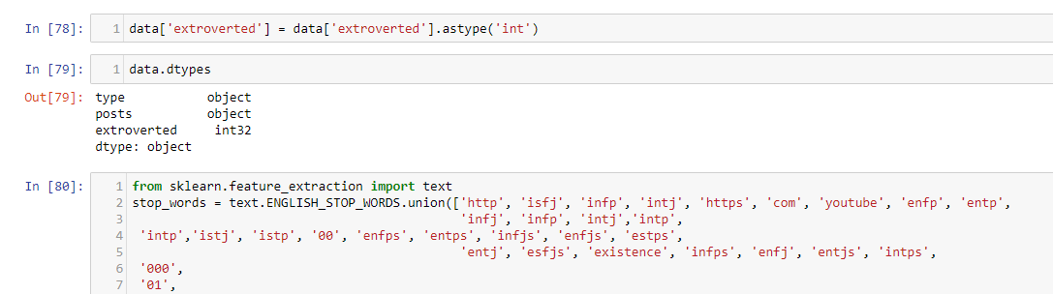
Create Stopwords

Slide 31
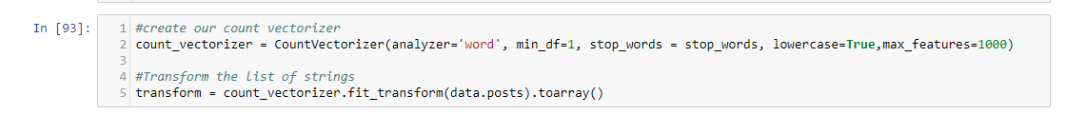
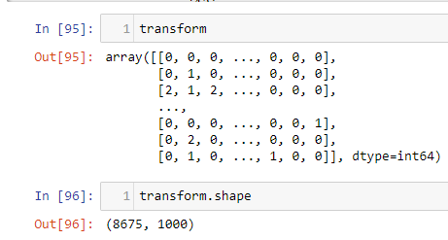
Count Vectorizer

Slide 32
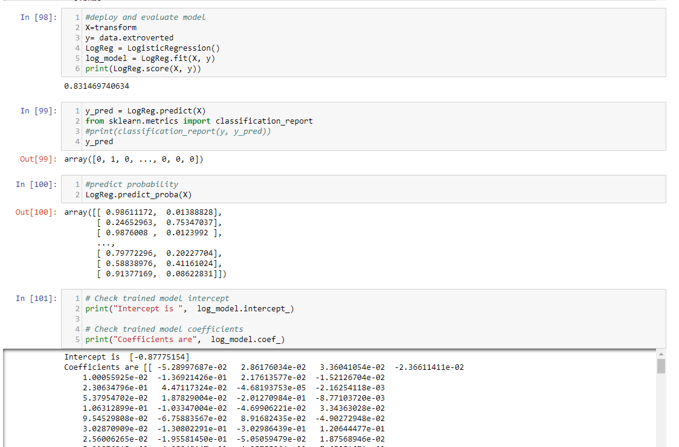
Initial Logistic Regression

Slide 33
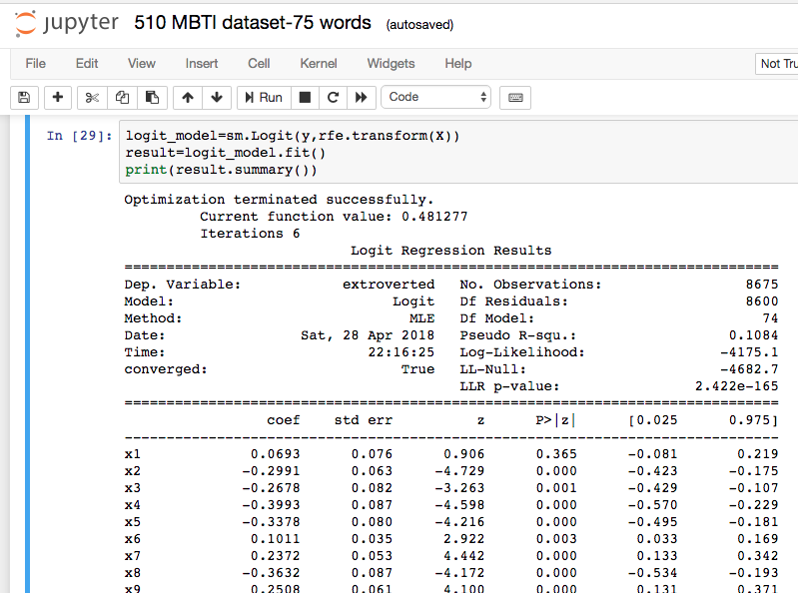

Slide 34
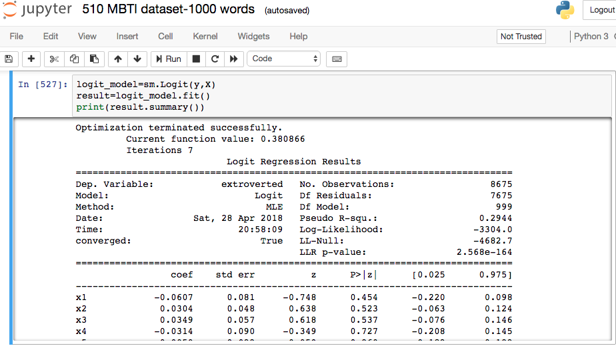

Slide 35
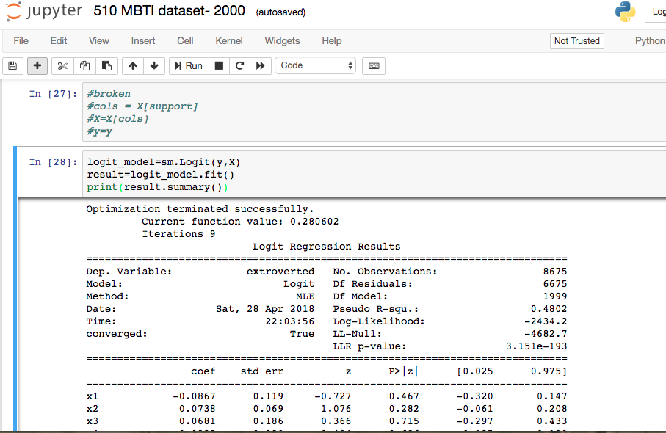

Slide 36
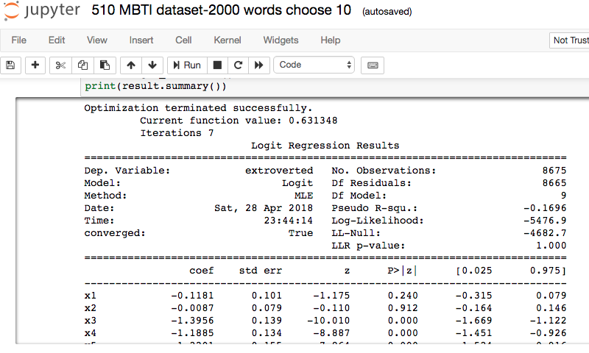

Slide 37
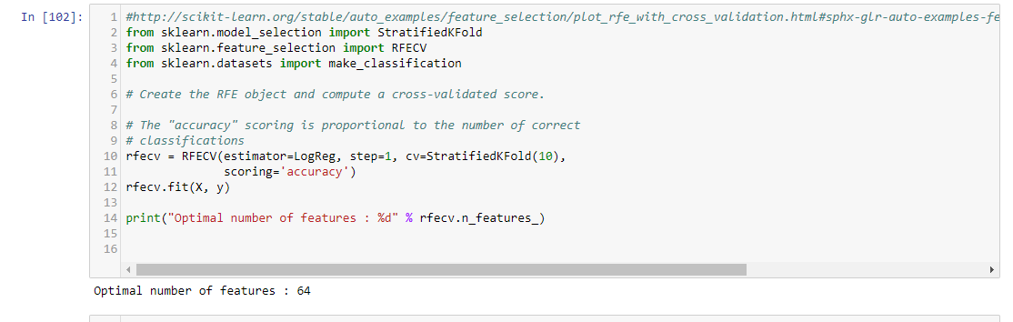
Using Recursive Feature Selection with Cross Validation

Slide 38
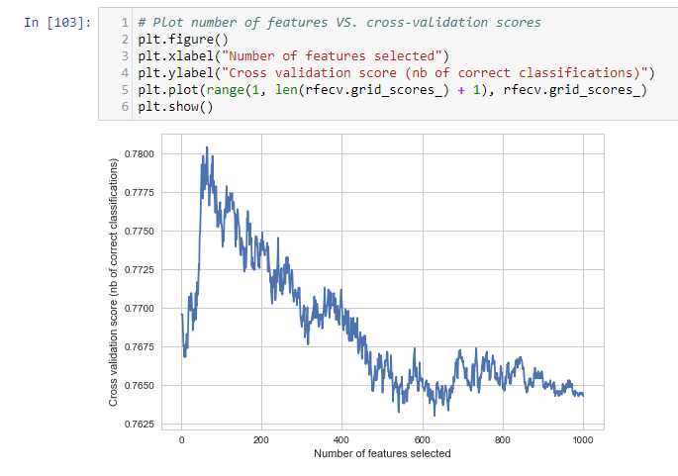

Slide 39
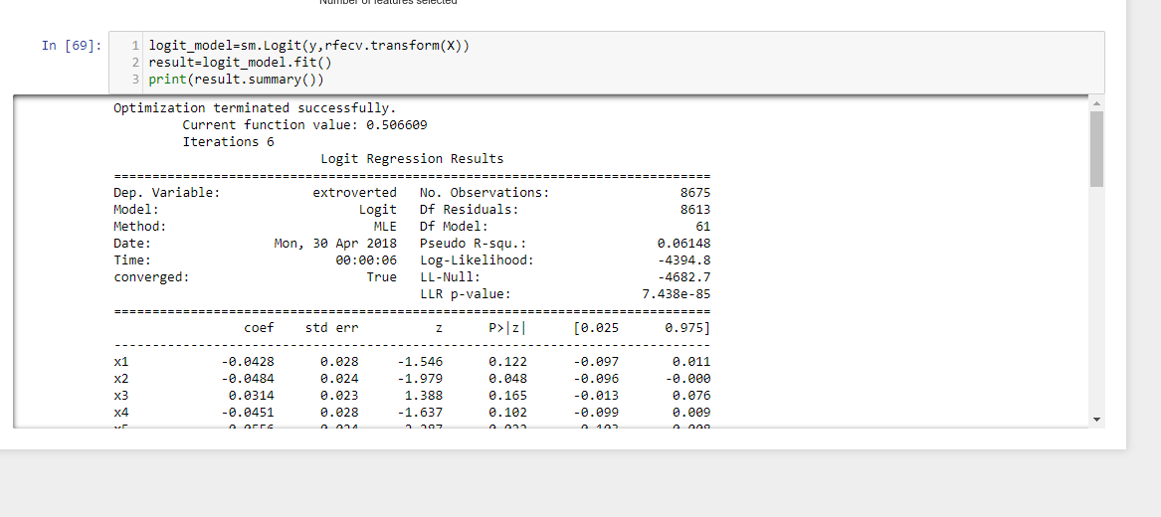
Using RFECV (Recursive Feature Elimination Cross Validation) 1000 Words

Slide 40
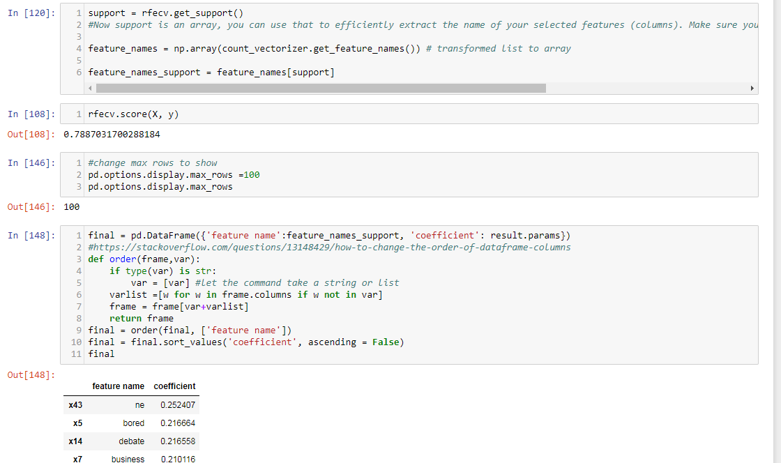
RFECV scores and feature names

Slide 41
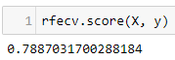
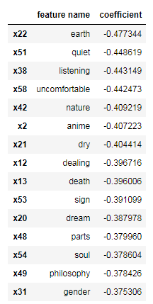
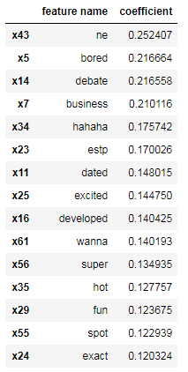
Conclusion:
Words used in posts can be used to predict temperament (at least introverted/extrovertedness)
Introverted Words
Extroverted Words
Top 15

Slide 42
Next Steps
More Data
Better computer
Compare performance of other models/classifiers
Try using ngrams
Look at each other axis N/S, F/T, J/P
Notes:
(also review stop words list)

Slide 43
Case Study 2
How to predict a categorical response?
Ordered (Ordinal:)

Slide 44
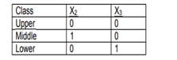
How to predict a categorical response?
Ordered (Ordinal:)
Example of ordinary variables
The following example illustrates the fitting and interpretation of a multiple logistic regression model that involves both quantitative and categorical predictor variables.
· Age (X1): a quantitative variable;
· Socioeconomic status of household. This is a categorical variable with three levels. It is coded by two indicator variables (X2 and X3) as follows:
· City sector (X4): Since there were only two sectors in the study, one indicator variable was used, defined as X4 = 0 for sector 1 and X4 = 1 for sector 2.
The primary purpose of the study was to assess the strength of the association between each of the predictor variables and the probability of a person having contracted the disease.

Slide 45
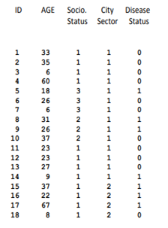
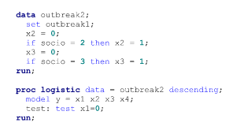
How to predict a categorical response?
ordinal:

Slide 46
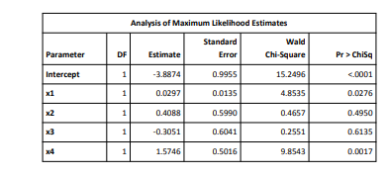
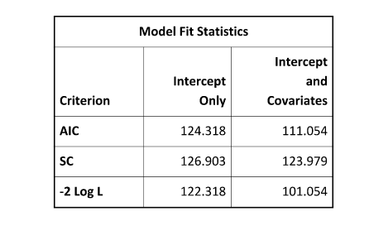
SAS output

Slide 47
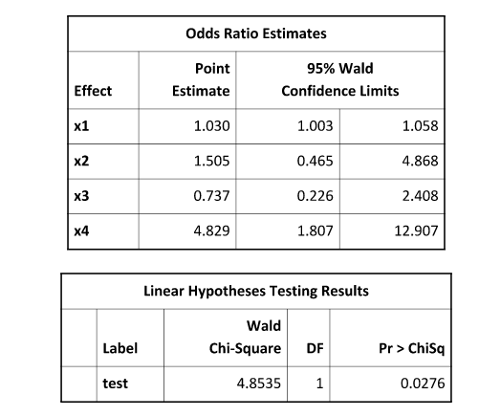

Slide 48
Multinomial Models
Create multiple dummy regressions, each calculated simultaneously.
For multinomial models (more than 1 possible response) ????
https://www.mathworks.com/help/stats/multinomial-models-for-nominal-responses.html
http://amunategui.github.io/multinomial-neuralnetworks-walkthrough/
https://www.theanalysisfactor.com/logistic-regression-models-for-multinomial-and-ordinal-variables/
R walkthrough

Slide 49
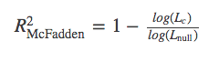
A deeper look at Logistic Regression
How do you analyze a logistic regression?
Can we use r squared? Nope. Use Psuedo R^2
Notes:
http://thestatsgeek.com/2014/02/08/r-squared-in-logistic-regression/

Slide 50
References
https://en.wikipedia.org/wiki/Ordinal_regression
Ordinal Responses
Maybe an example? Which factor effects quality most? (Highest correlation) (https://www.kaggle.com/uciml/red-wine-quality-cortez-et-al-2009)
https://en.wikipedia.org/wiki/Ordered_logit
Example of ordered regression problems:
https://stats.idre.ucla.edu/r/dae/ordinal-logistic-regression/
In SPSS
https://www.ibm.com/support/knowledgecenter/en/SSLVMB_22.0.0/com.ibm.spss.statistics.help/spss/categories/idh_catr.htm
General information on categorical data
http://www.ucd.ie/statdept/classpages/categorical_data_analysis/cda1.pdf

Slide 51
References for R, SAS, & Python
https://www.analyticsvidhya.com/blog/2015/08/comprehensive-guide-regression/
R tutorial on running a logistic regression:
https://www.r-bloggers.com/how-to-perform-a-logistic-regression-in-r/
R tutorial on building a logistic regression from scratch:
https://www.analyticsvidhya.com/blog/2015/10/basics-logistic-regression/
Python walkthrough: https://towardsdatascience.com/logistic-regression-using-python-sklearn-numpy-mnist-handwriting-recognition-matplotlib-a6b31e2b166a
https://towardsdatascience.com/building-a-logistic-regression-in-python-step-by-step-becd4d56c9c8
SAS example:
http://support.sas.com/documentation/cdl/en/statug/63962/HTML/default/viewer.htm#statug_logistic_sect060.htm
Recursive Feature Selection with Cross Validation example in Python
http://scikit-learn.org/stable/auto_examples/feature_selection/plot_rfe_with_cross_validation.html#sphx-glr-auto-examples-feature-selection-plot-rfe-with-cross-validation-py
Changing order of dataframes
#https://stackoverflow.com/questions/13148429/how-to-change-the-order-of-dataframe-columns

Slide 52



THANKS!

Slide 53


Any questions on Multivariate Regression with Categorical Response ?
robertnakano@gmail.com
afsanehkhani35@gmail.com
joannewangziyi@gmail.com
Link to slides: https://tinyurl.com/y93zm5bv

Slide 54
CREDITS
Special thanks to all the people who made and released these awesome resources for free:
Presentation template by SlidesCarnival
Photographs by Unsplash

